Slide 1
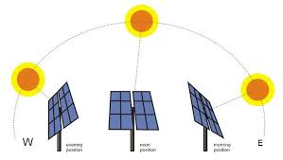
SOLAR TRACKER ARRAY

Slide 2
Abstract
Typically, a solar tracking system adjusts the face of the solar panel or reflective surfaces to follow the movement of the Sun.
The movement of solar trackers increases the solar energy output by up to 40% than standard panels.
Solar trackers are increasingly used in both residential and commercial-grade solar panels due to improved and more efficient solar trapping technology.

Slide 3
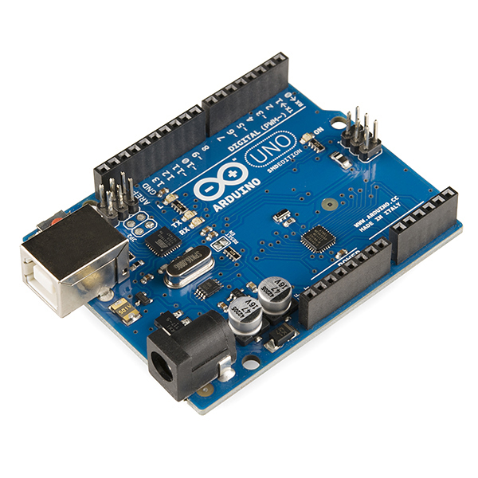
componets:
Ardunio uno:

Slide 4
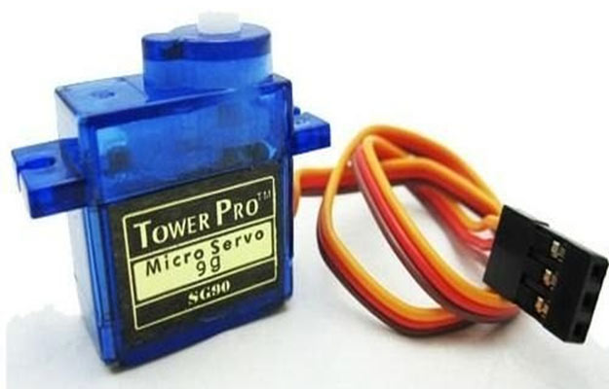
Servo motor:
This servo motor is programable by ardunio uno board any axis of Sun

Slide 5
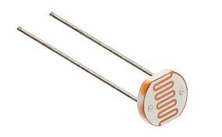
LDR senor:

Slide 6
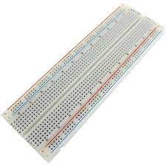
BREAD BOARD :

Slide 7

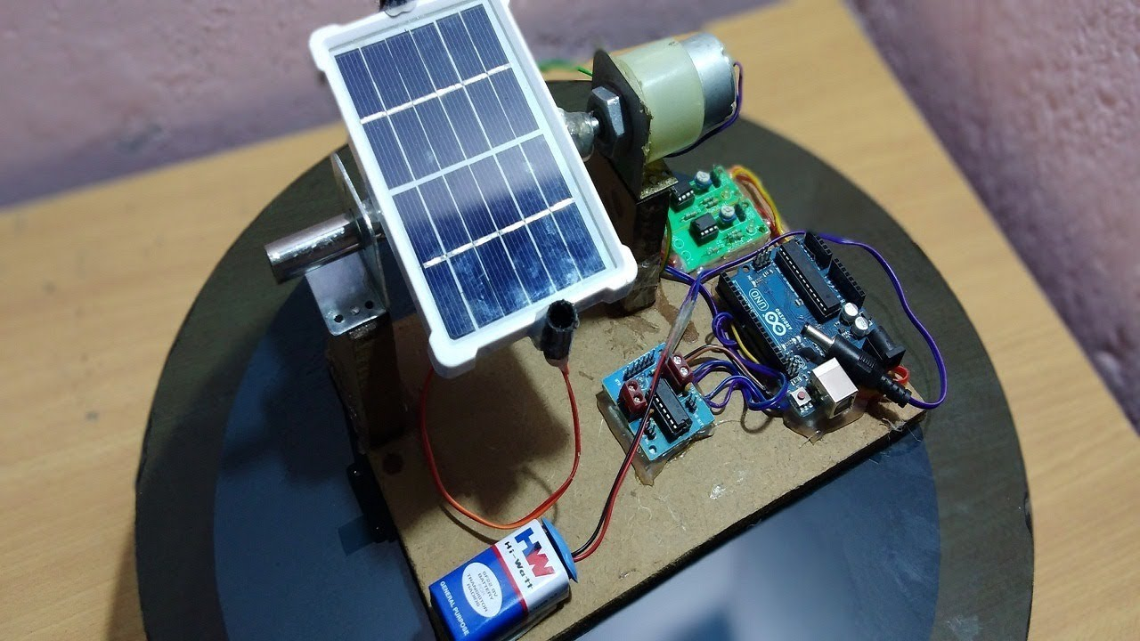
OUT PUT IMAGE

Slide 8
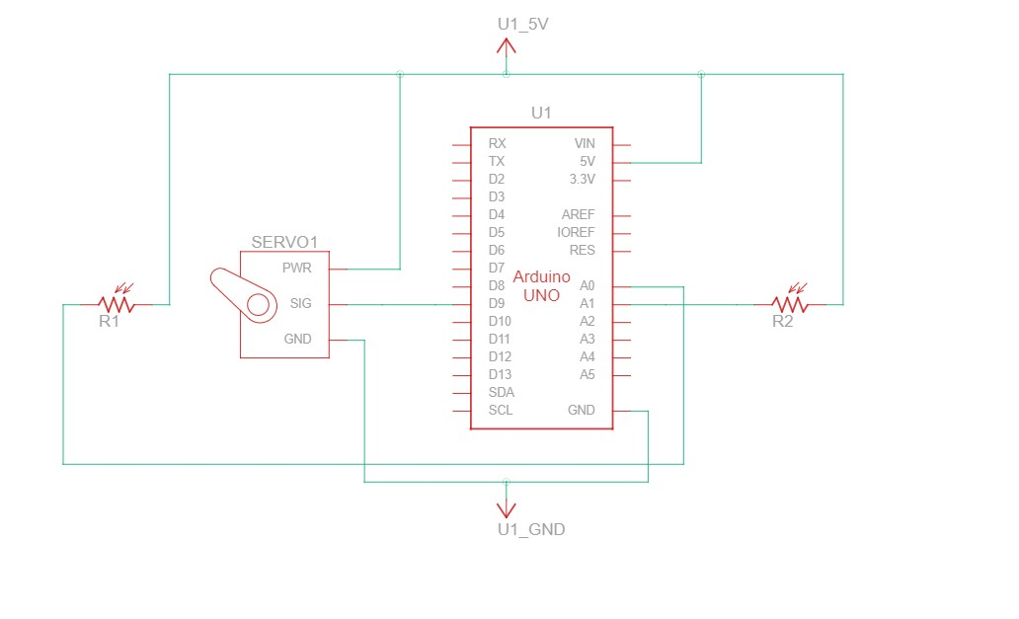
Block diagram

Slide 9
Procedure
So, first things first, you need some solar panels. I used two, although you can use however many you want, just think about how much a 9gram servo is going to be able to lift/lower (don’t make it too heavy). The panels I found were rated at 1.5V, 0.75W
output which is on the lower end available these days. But they were light and cheap and given this is a proof of concept project for me, the output isn't super important.
I joined my two panels along the edge with epoxy. To connect the panels into a string, just solder the positive lead of one panel to the negative lead of the other, which should leave you with a positive and negative wire left over. Attach your two LDR's to
each side of the solar panel (East and West), and solder one end of a jumper wire to each of their leads. Its easier to solder a jumper wire if you cut the end off one side, and strip the lead about 5mm to expose the wires.

Slide 10
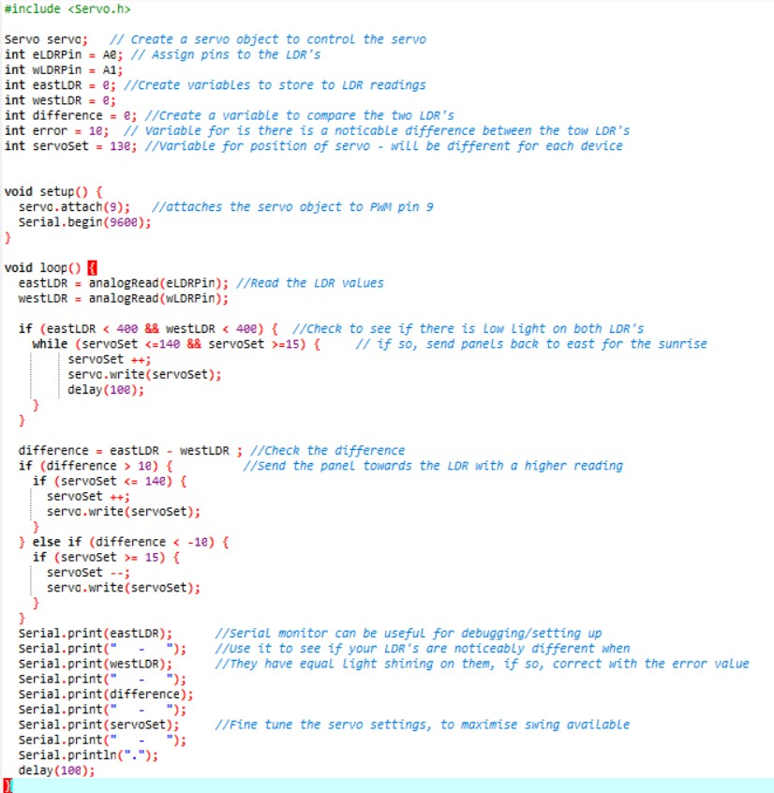
Code

